Slide 1


CMR TECHNICAL CAMPUS UGC (Autonomous) Kandlakoya, Medchal Road, Hyd-501401 Department of Computer Science and Engineering
ESTD: 2009
A
Mini Project On
AGRICULTURE HELPER CHATBOT
BATCH NO: 08
GROUP MEMBERS :
207R1A0587 K.Harshitha
207R5A05B0 P.Karthik
207R1A0598 Mohammed Mokhim
UNDER THE GUIDANCE OF:
A.Uday Kiran
(Assistant Professor)

Slide 2
CONTENTS
Abstract
Existing System
Disadvantages in Existing System
Proposed System
Advantages of Proposed System
Hardware and Software Requirements
Novelty
Architecture
Modules
UML Diagrams
Sample Code
Results
Conclusion
Future Scope
References
Github Link

Slide 3
Abstract
As India has an agro-based economy, 58% of its population relies on agriculture as it's primary method of livelihood.
The economic survey for 2019-2020 indicates that agriculture growth in India has stagnated around 2.9% annually for the past 6 years.
This problem can be solved by providing farmers with expert advice and relevant information
Example: Determine when to irrigate, how to sow seeds, and which pesticides to use effectively to increase the yields.
ChatBot can overcome the problems by allowing farmers to obtain the information they need to succeed in an ever-changing market and to enlarge with new technology and market demand in an easy-to-use manner.
Farmers can communicate easily with the CHATBOT since the system uses NLP (Natural Language Processing)

Slide 4
Existing System
If a plant is deficient in a specific nutrient, it can exhibit some symptoms.
Growing plants are the things that the grower is interested in because they serve as integrators of all growth factor.
As a result, a close examination of the growing plant will aid in the identification of a particular nutrient stress.
Only when the nutrient supply is so poor that the plants can no longer survive properly do sign of nutrient deficiency appears.
It would have been more cost-effective to apply fertilizer long before the symptoms occurred in such cases.

Slide 5
Disadvantages in Existing System
Less Accuracy
Low Efficiency

Slide 6
Proposed System
In the proposed system, we developed an application that is Chatbot for farmers, where Chatbot ask farmer to upload crop image and then application will apply CNN algorithm to predict disease from that crop leaf and display possible remedies.
After getting remedies user can ask question related such as crop name and then Chatbot will display soil, rainfall and other details.
User can ask question chatbot in their voice and application will use speech recognition algorithm to understand farmer question and then display answer.

Slide 7
Advantages of Proposed System
High Accuracy
High Efficiency

Slide 8
Hardware and Software Requirements
Hardware Requirements:
System : i3 or above
RAM : 4GB
Hard disk : 40GB
Software Requirements:
Operating System : Windows 8 or above
Coding Language : Python

Slide 9
NOVELTY
The agriculture helper chatbot has several novel features that set it apart from traditional methods of providing information and advice to farmers. The following are some of the key novelty features:
Personalization: The chatbot uses machine learning algorithms to provide personalized recommendations and advice to farmers based on their query and other relevant information such as weather conditions and soil moisture. This personalized approach ensures that farmers receive tailored advice that is specific to their needs and circumstances.
Natural language processing: The chatbot uses natural language processing techniques to understand the farmer's query and provide a relevant response. This feature allows farmers to communicate with the chatbot using natural language queries or through pre-defined menus, making it more user-friendly and accessible.
24/7 accessibility: The chatbot is accessible 24/7, which means that farmers can access information and advice whenever they need it. This feature is particularly valuable for farmers who may have limited access to traditional sources of information and advice.

Slide 10
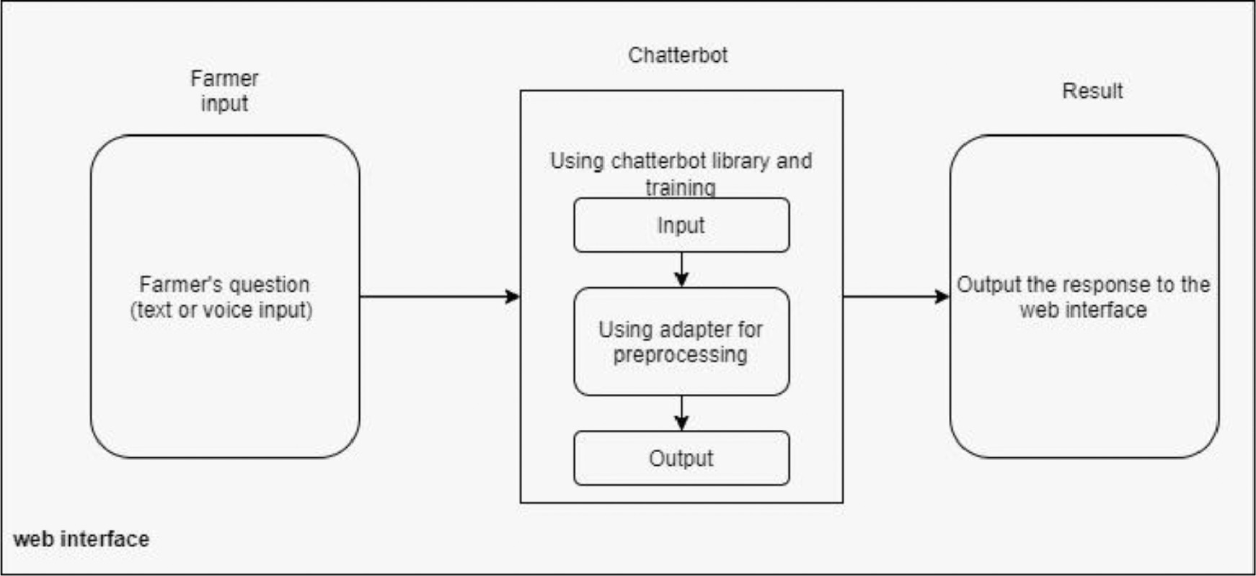
Architecture

Slide 11
Modules
There are several modules and technologies that can be used to develop an agriculture helper chatbot project.Here are some key modules:
Natural Language Processing(NLP) Libraries
Crop and Pest Databases
Database and Storage
Web Development Frameworks

Slide 12
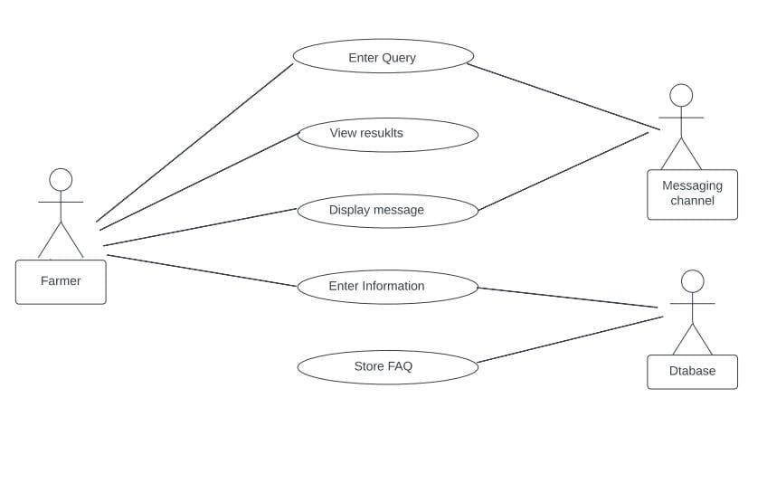
UML Diagrams
Usecase Diagram

Slide 13
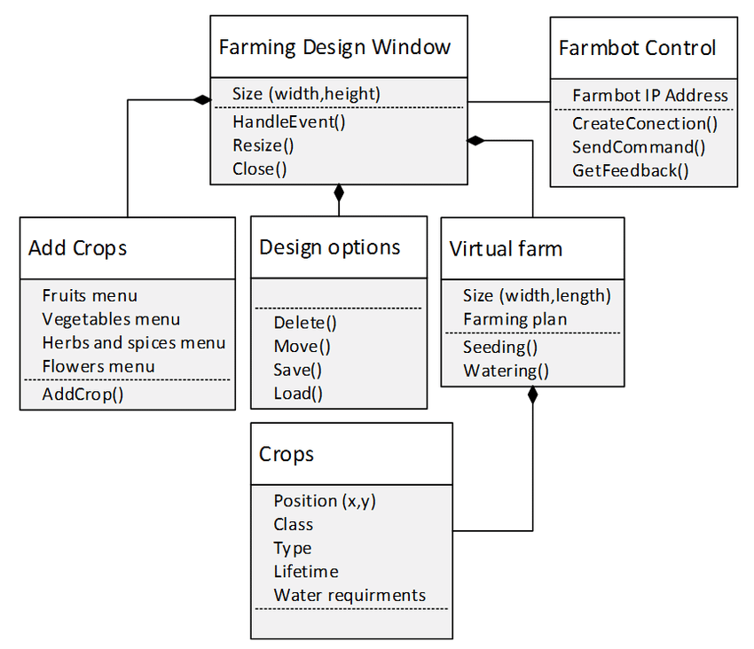
Class Diagram

Slide 14
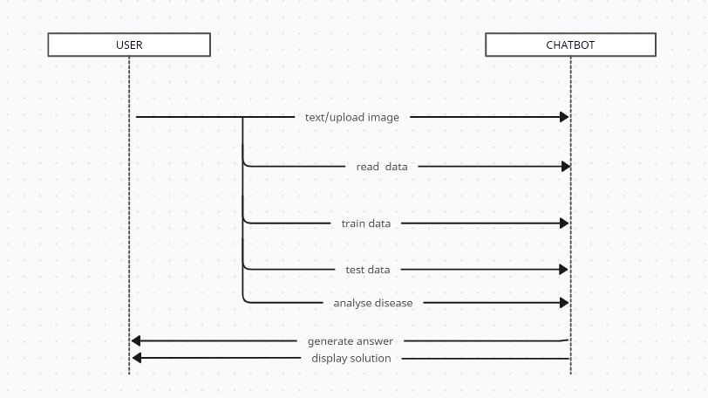
Sequence Diagram

Slide 15
Activity Diagram

Slide 16
Source Code
import pandas as pd
import numpy as np
question = []
answer = []
dataset = pd.read_csv("Messages/diseases.txt", encoding='iso-8859-1',header=None)
dataset = dataset.values
for i in range(len(dataset)):
disease = dataset[i,0]
remedy = dataset[i,1]
question.append(disease.strip().lower())
answer.append(remedy)
dataset = pd.read_csv("Messages/chatbot.csv",encoding='iso-8859-1')
dataset = dataset.values

Slide 17
Source Code
for i in range(len(dataset)):
crop = dataset[i,0]
rainfall = str(dataset[i,1])
soil = str(dataset[i,2])
irrigation = str(dataset[i,3])
question.append(crop.strip().lower())
answer.append(rainfall+" "+soil+" "+irrigation)
tfidf_vectorizer = TfidfVectorizer(use_idf=True, smooth_idf=False, norm=None, decode_error='replace')
tfidf = tfidf_vectorizer.fit_transform(question).toarray()
print(tfidf)

Slide 18
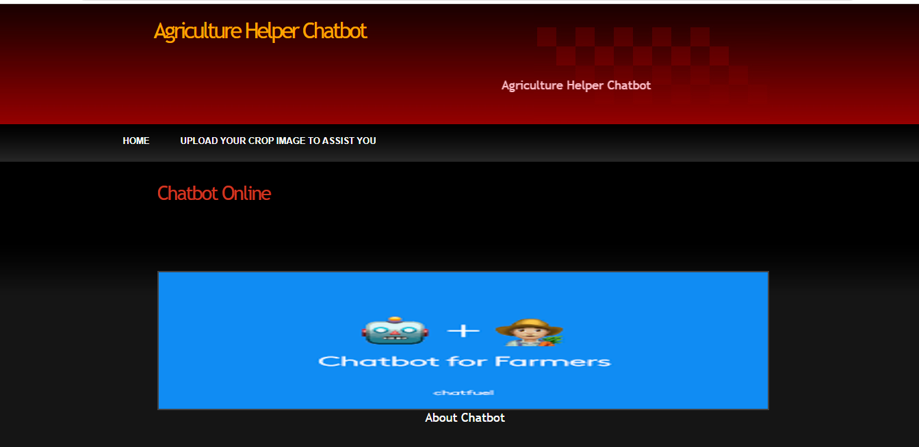
Results
Figure 1 : Chatbot Application

Slide 19
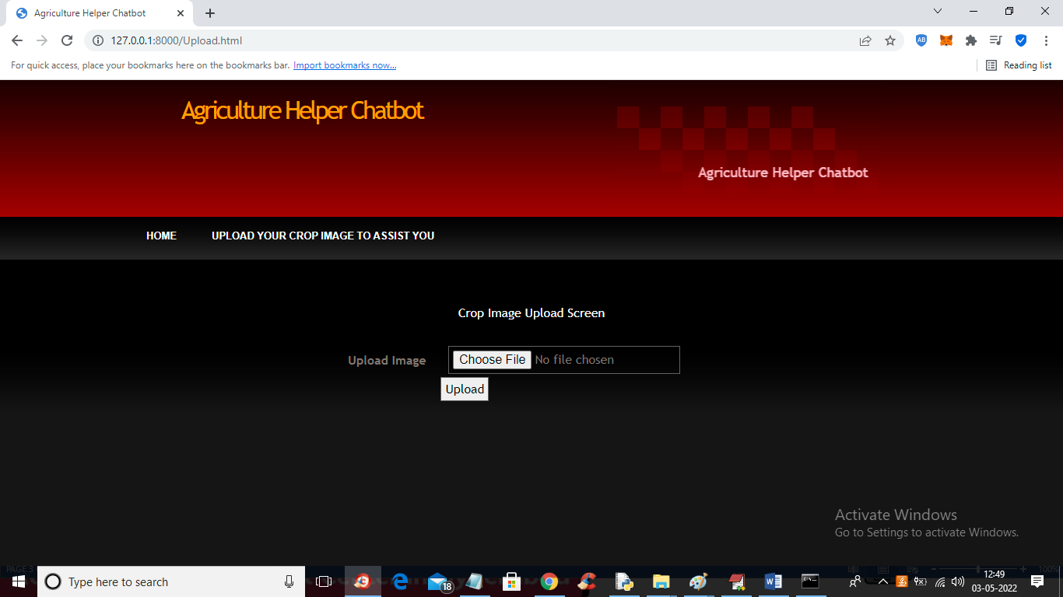
Figure 2 : Upload Crop Image

Slide 20
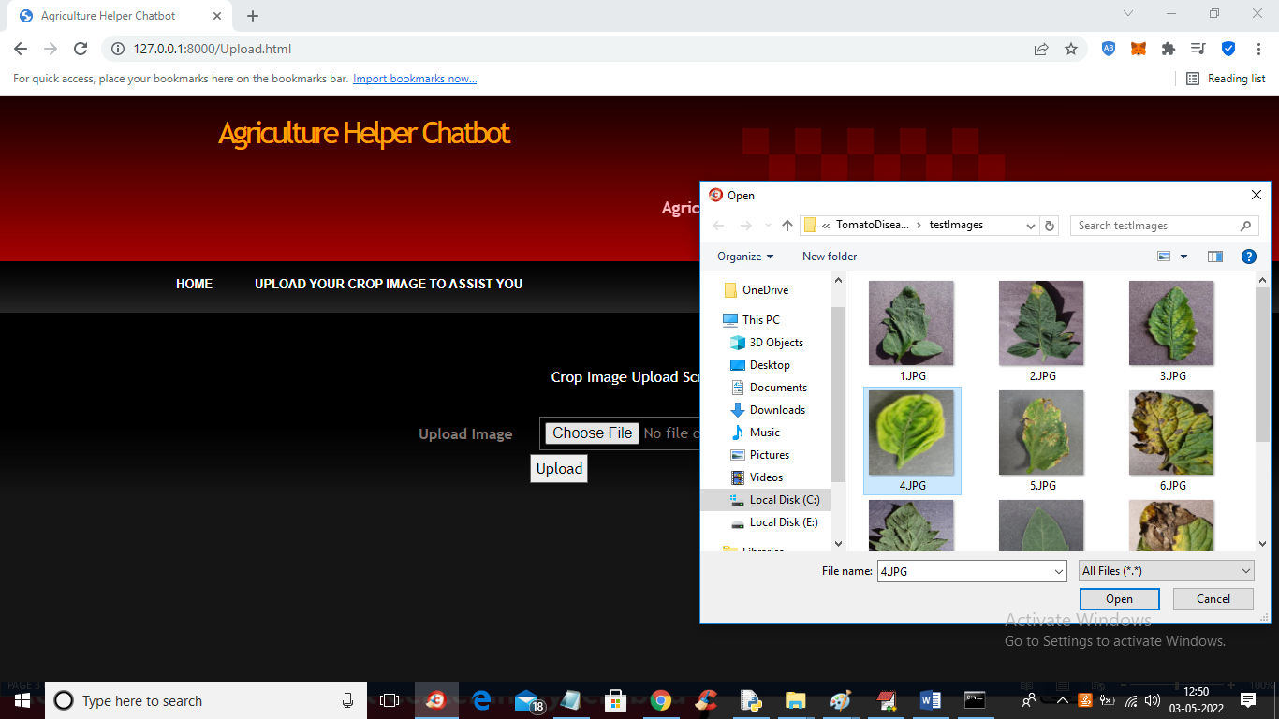
Figure 3 : Selecting file to upload

Slide 21
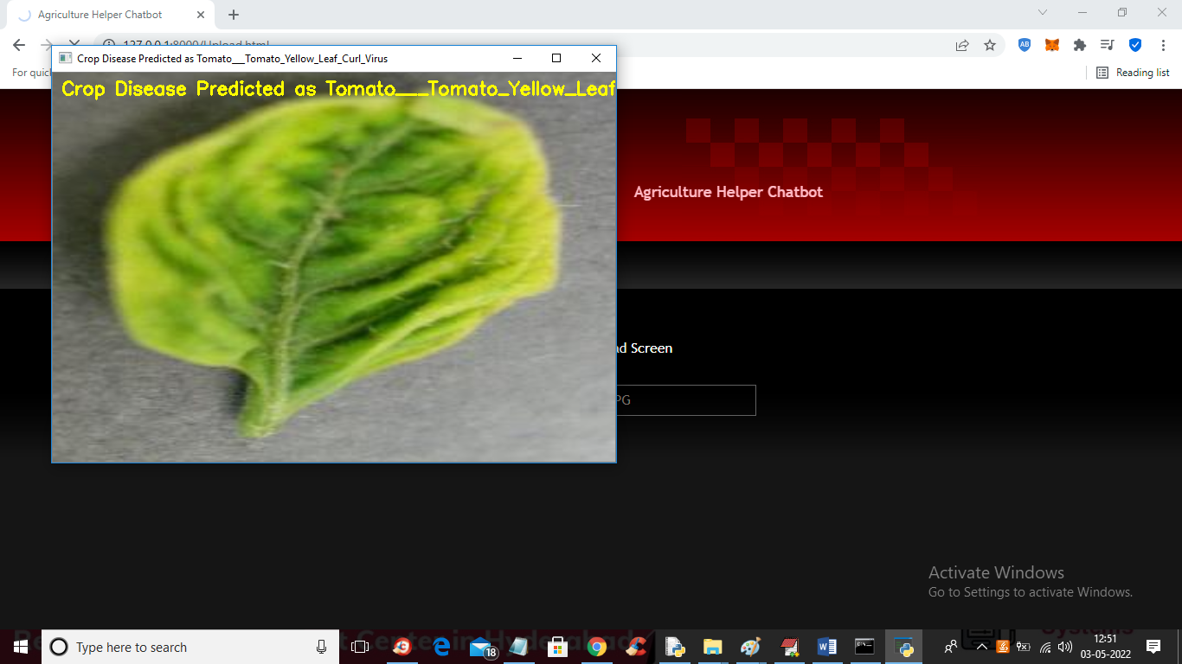
Figure 4 : Crop disease predicted

Slide 22
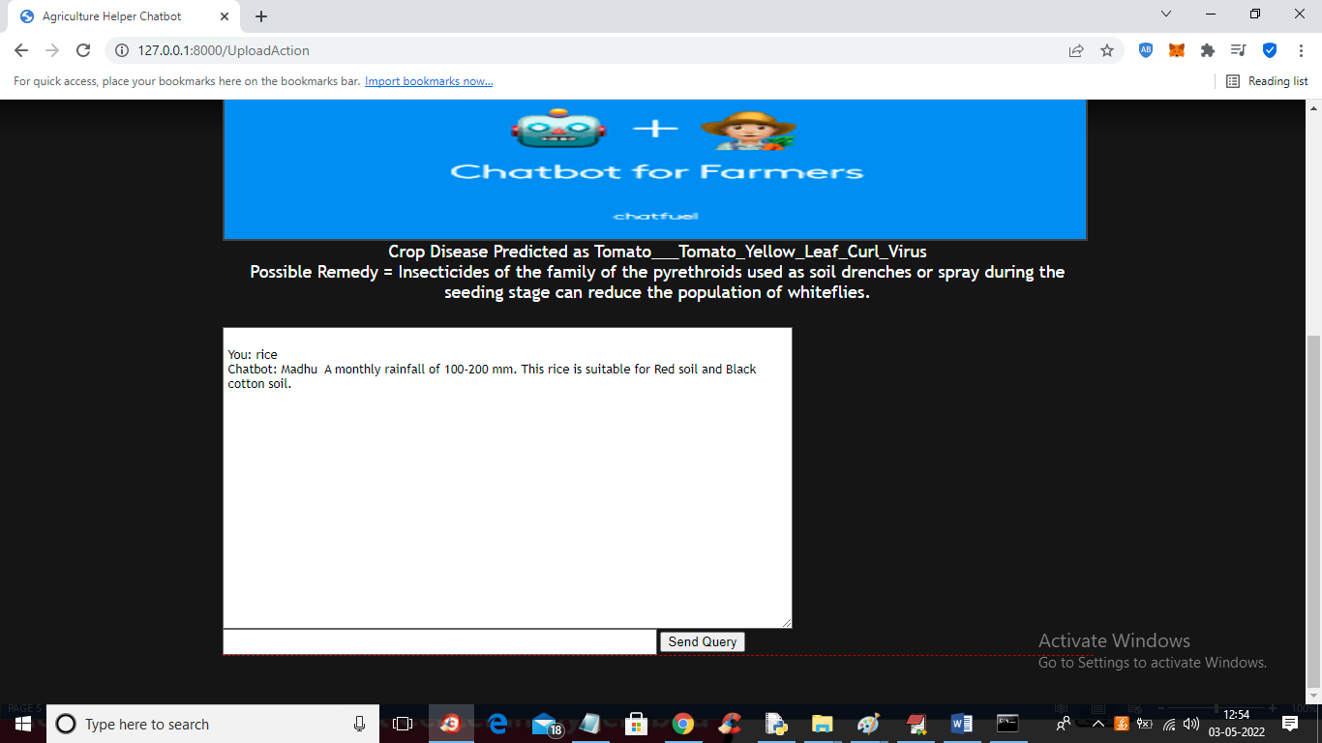
Figure 5 : Query through text area

Slide 23
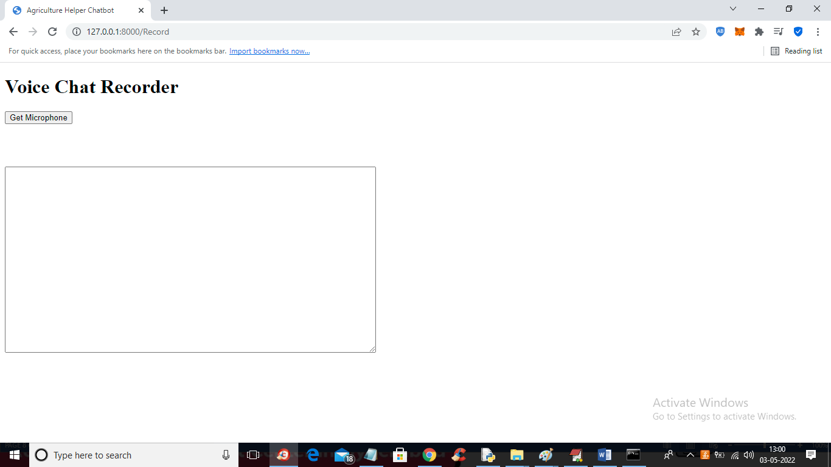
Figure 6 : Query through Voice search

Slide 24
Conclusion
An agriculture helper chatbot can be a valuable tool for farmers and other individuals in the agriculture industry.
It can assist and provide valuable insights recommendations to improve efficiency and productivity.
An agriculture helper chatbot has the potential to revolutionize the industry and help farmers to navigate the complex challenges of modern agriculture.
Our system would enable the farmer to ask any number of questions, anytime, which will in turn help in spreading the modern farming technology faster and to a higher number of farmers.

Slide 25
Future Scope
The future scope for an agriculture helper chatbot project is promising, as it can address several challenges and opportunities in the agriculture sector. Here are some potential areas of growth and development for this project:
Crop Management and Advisory Services
Disease and Pest Detection
Soil Health Assessment
Mobile App Integration

Slide 26
References
J. Vijayalakshmi,K. PandiMeena, “Agriculture TalkBot Using AI”, International Journal of Recent Technology and Engineering (IJRTE) ISSN: 2277 – 3878, Volume-8, Issue-2S5, July 2019.
J. Bang, H. Noh, Y. Kim and G. G. Lee, "Example-based chat oriented dialogue system with personalized long-term memory", 2015 International Conference on Big Data and Smart Computing (BIGCOMP), Jeju, 2015.
E. Haller and T. Rebedea, "Designing a Chat-bot that Simulates an Historical Figure," 2013 19th International Conference on Control Systems and Computer Science, Bucharest, 2013.
S. J. du Preez, M. Lall and S. Sinha, "An intelligent web-based voice chat bot," EUROCON 2009, EUROCON '09. IEEE, St.-Petersburg, 2009. [6] Y. Chen, W. Wang and Z. Liu, "Keywordbased search and exploration on databases," 2011 IEEE 27th International Conference on Data Engineering, Hannover, 2011.
B. K. Kim, J. Roh, S. Y. Dong, and S. Y. Lee, “Hierarchical committee of deep convolutional neural networks for robust facial expression recognition,” Journal on Multimodal User Interfaces, pp. 1-17, 2016.
L. Chao, J. Tao, M. Yang, Y. Li, and Z. Wen, “Audio Visual Emotion Recognition with Temporal Alignment and Perception Attention,” arXiv preprint arXiv:1603.08321, 2016.
H. Lee, Y. S. Choi, S. Lee, and I. P. Park, “Towards unobtrusive emotion recognition for affective social communication,” In proc. Of 2012 IEEE Consumer Communications and Networking Conference, pp. 260-264, 2012.

Slide 27
Github Link
https://github.com/Harshitha-31/Agriculturehelper-Chatbot-

Slide 28
Thank You

